Slide 1
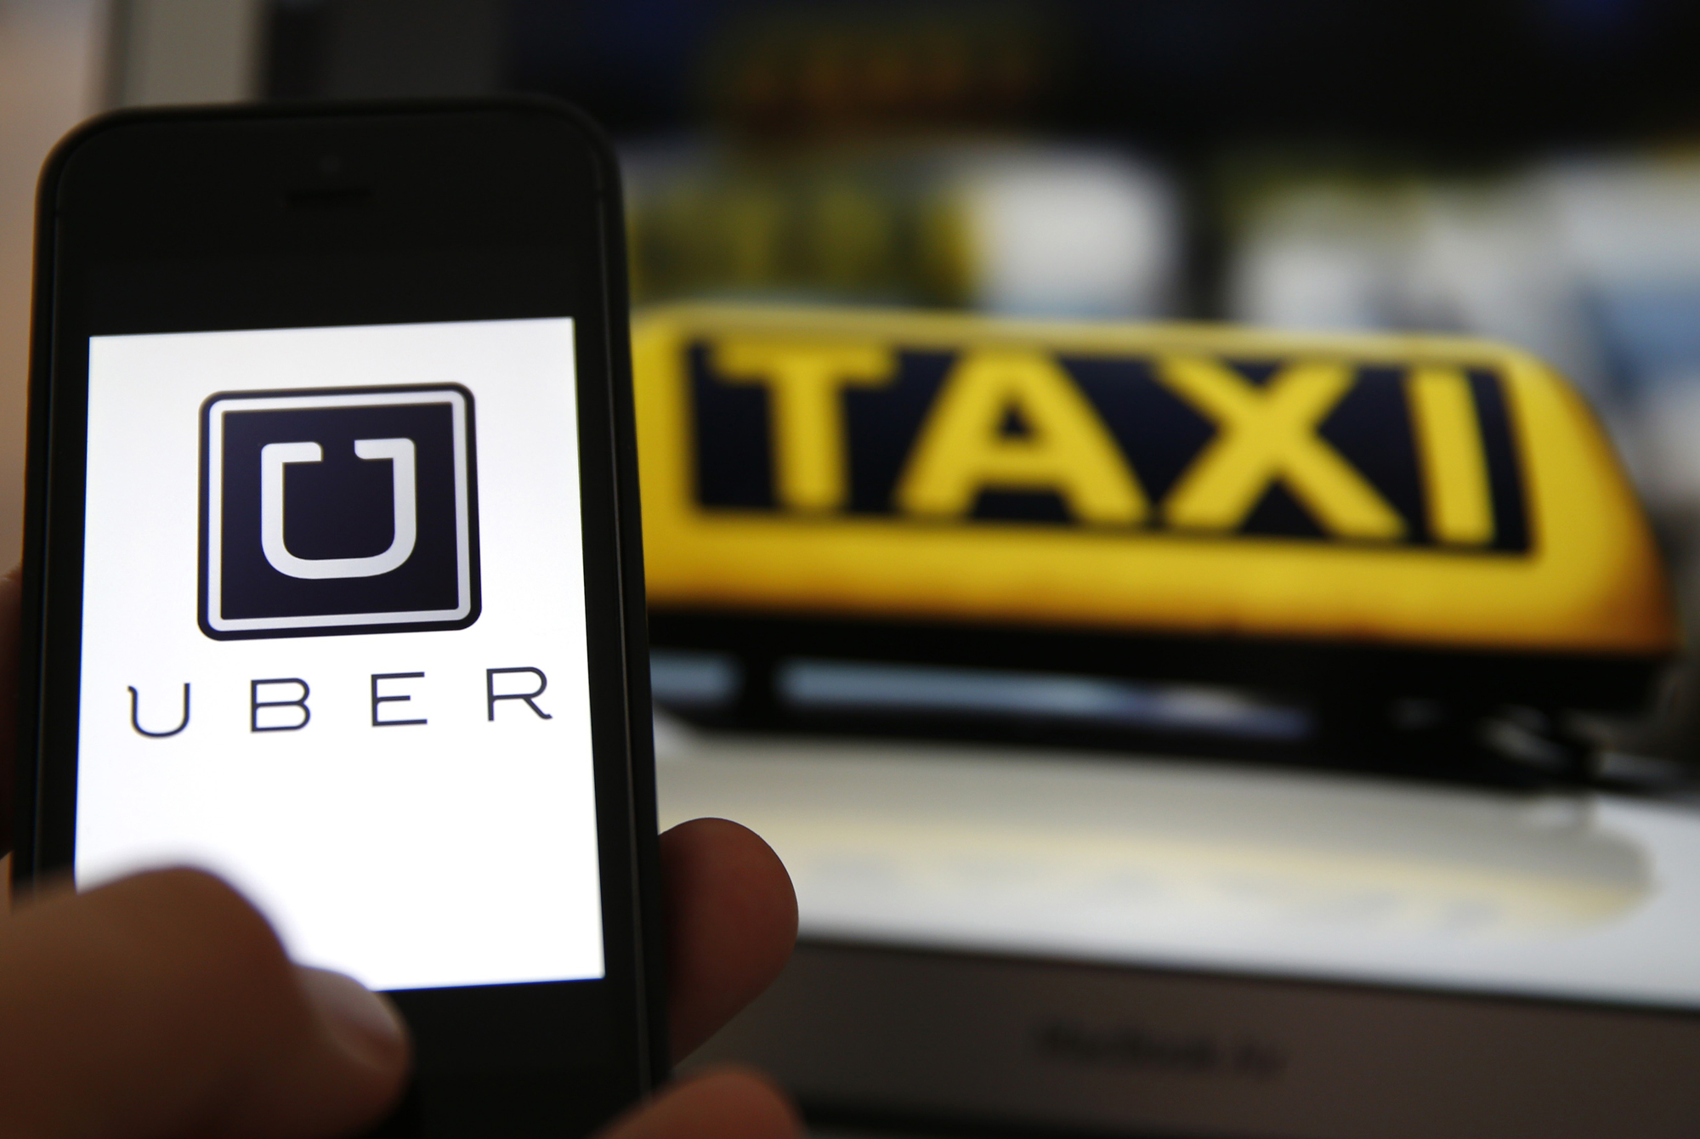
Presentation by
Khushboo Nandal
This Photo by Unknown Author is licensed under CC BY-ND

Slide 2
CONTENT
UBER concept.
UBER – A partnership model.
Price calculation.
Brand Rider Interface
The success of UBER Business.
Substitute for taxis.
UBER traffic in NYC.
UBER journeys per day.
UBER journeys per hour.
Quality Assurance.

Slide 3
UBER Concept
A fast & efficient on-demand car service.
Market : Professionals in America cities.
Convenience of a cab in NYC + Experience of a professional chauffeur.
Latest consumer web & device technology.
Optimized fleets and incented drivers.
The “NetJets of car services”.

Slide 4
UBER – A PARTNERSHIP MODEL
Uber doesn’t employ its drivers. It partners with them. Uber has argued several times how it is not a transportation company, rather a technology or service provider, according to sources. Drivers set their own work structure and hourly duration and are under nominal control. They have all rights to accept or reject the terms and conditions of the contract and can collaborate with Uber for a desired span of time.
How Uber makes money?
Uber collaborates with vehicle owners and drivers and together they set up a minimum charge at which the partners will operate. Uber supplies them riders through online bookings from one single application and charges some amount of commission from them. The commission charged by the company ranges from 20% – 25% of the total amount charged from the customer. The Brand-Rider Interface

Slide 5
PRICE
Price Calculation
Uber sets the price of a ride as per kilometre charges and the time spent.
Dynamic Pricing
On bad weather days, hours of traffic congestion and on public holidays, when the demand for cab rides is higher than their availability, Uber clients have to deal with price surges. The company is totally transparent about this dynamic pricing strategy and informs the riders beforehand if there’s an increase in the price of the cab.

Slide 6

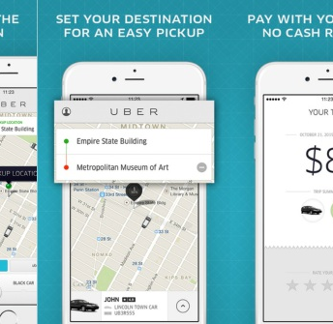
The Brand-Rider Interface
This Photo by Unknown Author is licensed under CC BY-SA
This Photo by Unknown Author is licensed under CC BY-NC-ND
The mobile application of Uber is available on iOS, Android as well as Windows platforms, and the clients use it to book rides. After a ride is completed, the client can rate his driver and the ride, and also address complaints and reports, if he has any. This information helps the Uber services to take necessary actions.

Slide 7
The Success of Uber Business Model
The Business Model of Uber is also profiting on several other levels. For instance, people hardly compare between transportation applications on their smartphone before going for a ride. Hence, a single mobile application is accumulating several customers worldwide.
Besides, the strong distribution network and the greater number of cars on the road provide better service to customers. The fares have an advantage too – and are pocket friendly. Also, an Uber ride costs lesser than one in your personal car, with your personal driver.
It is a blooming opportunity for vehicle owners who find the offer quite lucrative. With more and more people averting to ride-sharing companies for daily trips, it can actually be called an uber profit for drivers!

Slide 8
Substitute for Taxis
There’s not a single doubt regarding this that Uber has succeeded in replacing several taxis on the roads today due to the many facilities it offers.
There’s no refusal, unless in extreme cases when the driver can’t make it to the location within time, or when there are no cars available.
The system of reviewing and rating a ride, as well as complaining in case of any mishap is something taxis are lacing in.
The time constraint within which the cab is going to show up is always mentioned before a ride.
The driver can be contacted and all his details, including contact number and car details are shown to the client before the ride commences.
The route could be altered as per the flexibility of the client
The rates are reduced considerably in the case of UberPool – a ride-sharing service.
There are a variety of car types to choose from depending on the number of people and also on the standard of the ride.

Slide 9
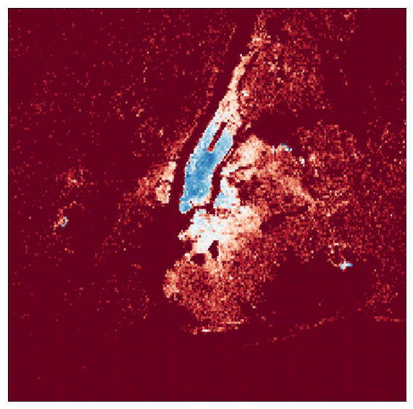
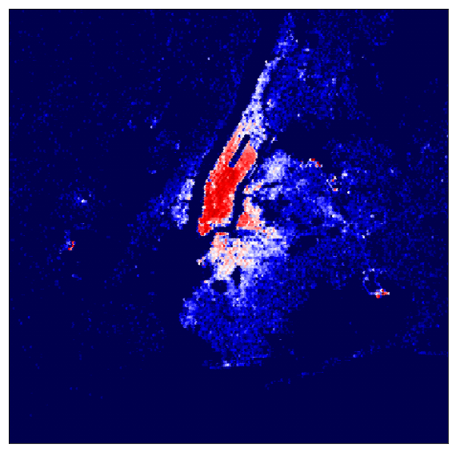
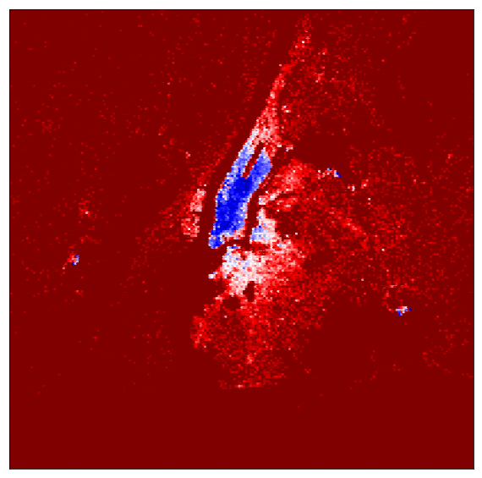
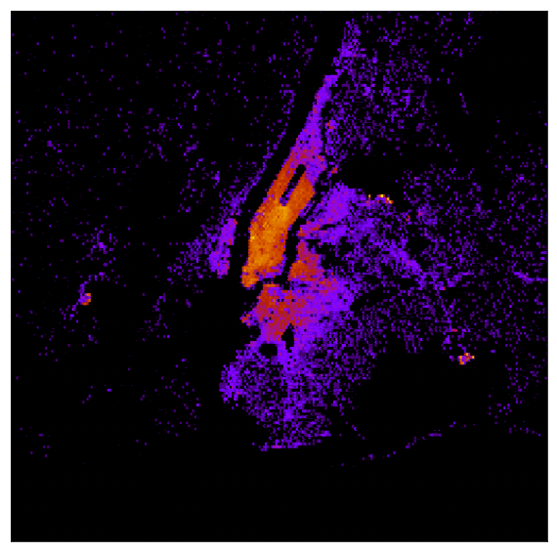
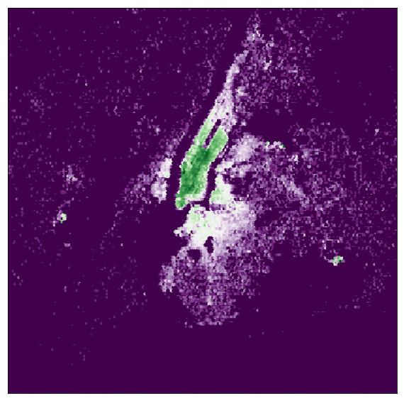
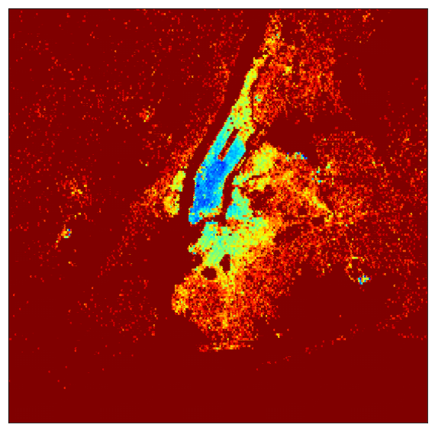
UBER’S TRAFFIC MOVEMENT
IN
NEW-YORK CITY
UBER’s traffic seems to be more active within city ie Manhattan, Brooklyn and Queens .Therefore , UBER can pool this area more ,to shorten taxi arrival time.
UBER can try extending its services in peripheral areas including long-trips and can cover airports also.

Slide 10
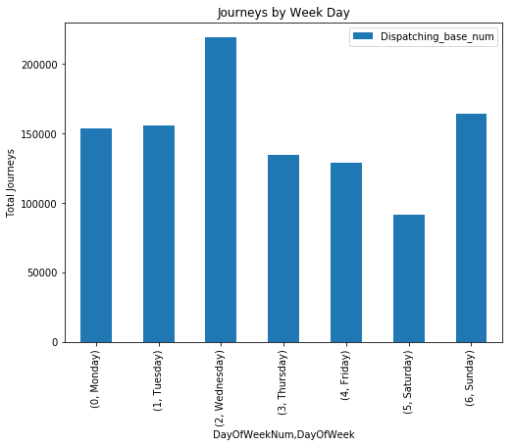
JAN- JUNE 2015
Monday-Wednesday being the most busy on week days and Sunday on weekend.
More active vehicles required on Wednesday and Sunday, to ensure availability and to prevent prolong waiting time.
Minimal fluctuation seen during the weekdays with steep rise on Wednesday.
Need to maintain quick availability for client satisfaction and own personal growth.

Slide 11
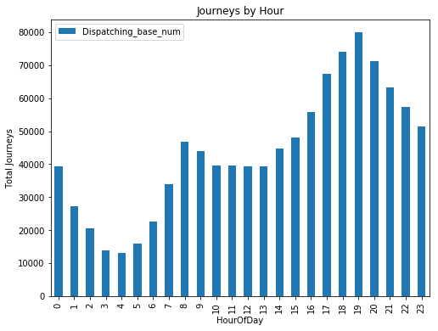
JAN- JUNE 2015
4 to 10 pm is peak business time , active vehicles ensures availability.
7 pm being the most rush hour so more active vehicles are required.
Off peak hour is from 2 to 6 am, so Uber vehicle must be available from 7 am to 10 pm in order to build reputation in taxi market.

Slide 12
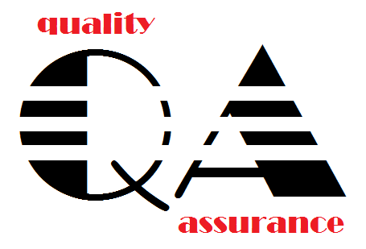

JAN- JUNE 2015
First graph indicates towards number of active vehicles.
Second graph shows total number of trips by UBER.
Same pattern in both the graphs indicates when it comes to safety & security UBER allows only affiliated vehicles to drive through and take bookings,

Slide 13
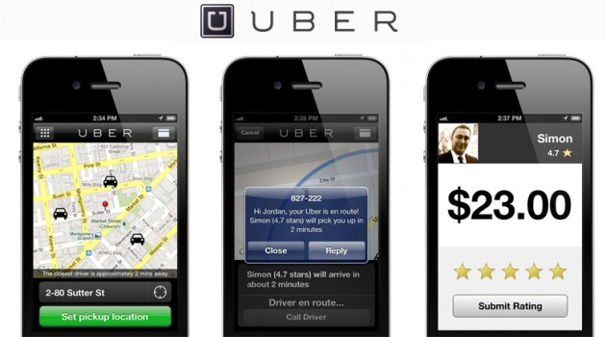


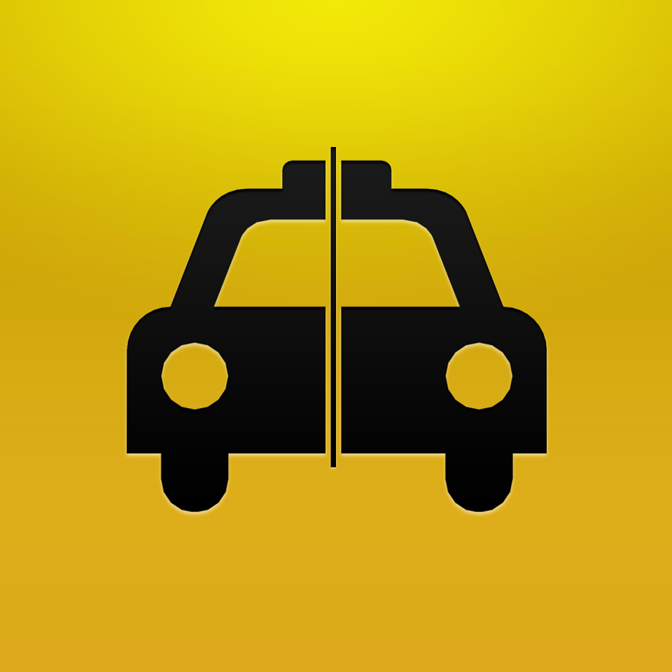



THANK YOU
This Photo by Unknown Author is licensed under CC BY-NC
This Photo by Unknown Author is licensed under CC BY-SA-NC
This Photo by Unknown Author is licensed under CC BY-SA

